Slide 1
TAKE BACK THE ECONOMY WOMEN WORKERS’ COOPERATIVE
BY HOPE & VICTOR

Slide 2
Background

Slide 3
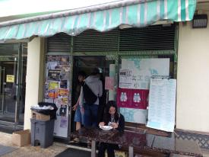
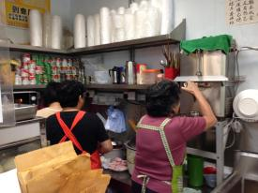
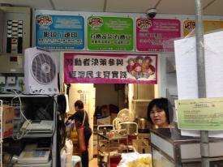
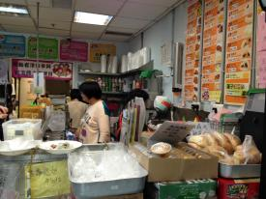
Women Workers’ Cooperatives ☺

Slide 4
At 2000

Slide 5
15th
year of the
cooperative!!!

Slide 6
Concept of Women Worker’s Cooperative
Worker Independence
Economic Democracy
Social Equality

Slide 7
CUHK Committee
Negotiation

Slide 8
Special Service period (11:00PM-1:30AM)
Release burden of workers

Slide 9
TAKE BACK THE BUSINESS

Slide 10
“In a community economy we’re interested in how surplus is produced, who owns it, who decides how it can be used, how it can be deployed to produce well-being for people ”
(Take back the economy, Page 54)

Slide 11
How Surplus is PRODUCED?
$$$$$$$$$$

Slide 12
Non Labour Cost
Survival Payment
Surplus
Revenue

Slide 13
Non-Labor Cost | Survival Payment | Surplus
 |  | Business payment | Collective wealth

Slide 14
/hr

Slide 15
PAYMENT
SURVIVAL
/hr

Slide 16
How they USE Collective Wealth

Slide 17
Video
Training and Support other cooperative
https://youtu.be/DWszOhmBC8A

Slide 19
Ways to use surplus ☺
Night Shift Subsidy
Saturday
Subsidy
Training Cost
Support for HKWWA
(Community Activity)

Slide 20
HOW THEY MAKE DECISION

Slide 21
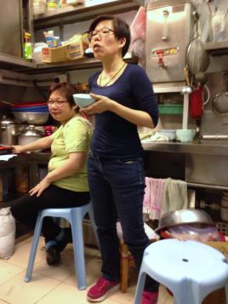
Meeting ☺

Slide 22
How do they make decision? (Video)
https://youtu.be/qMlvua8pepE

Slide 23
Meeting Agenda

Slide 24
Meeting Agenda

Slide 25
Meeting Agenda

Slide 26
(in MAY)
/hr

Slide 27
Raising Survival Payment Subsidies, Extra Payment (Bonus)

Slide 28
Ways to make decision
Consensus
Basis
Majority Rule
Convincing others

Slide 29
Dilemma encountered in meetings

Slide 30
Video
Dilemma of instant noodle
https://youtu.be/nkV4yal7HIo

Slide 31
Dilemma encountered
Whether or not to sell instant Noodle

Slide 32
Video
Dilemma of Organic Vegetable
https://youtu.be/tmr8Dyw7Mfo

Slide 33
Dilemma encountered
Whether or not to sell organic vegetable
$$$$$$$$$$

Slide 34
Dilemma encountered
Extra payment
Seniority + Social Activities

Slide 35
Video
Challenges to Traditional Economy
Challenges to Traditional Economy
https://youtu.be/4gmi2Q069hM

Slide 36
“To take back business so that it contributes to the well-being of people and the planet”
(Take back the economy, Page 51)

Slide 37
Survival well

Slide 38
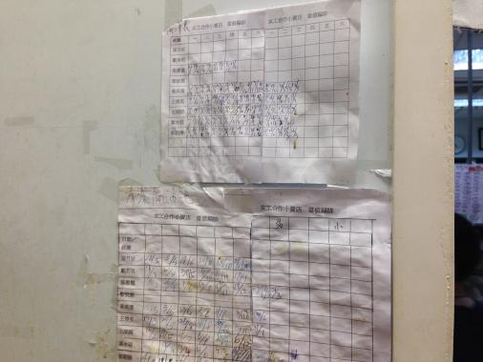
Flexibility

Slide 39
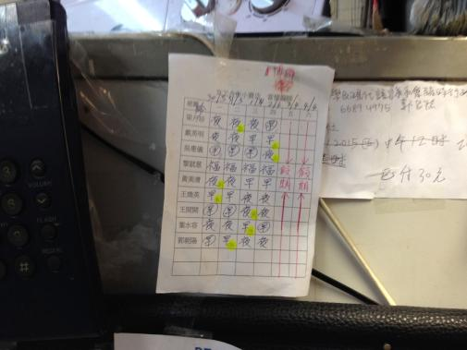
Flexibility

Slide 40
Well-being of people
Friendship
established
Decision powered
Management Skills learnt

Slide 41
From interviews
“In the past, I seldom talked much at work as I don’t want to be in trouble. But now in the cooperative, I feel a sense of dignity that I could speak out to improve the cooperative with others together. And also, I am more confident that I could even talk in front of strangers and cameras. Sometimes, I hang out with my friends in the cooperative that we would go out and see a movie ”
- Wun Ying
“I have learnt so many things in the cooperative. In the cooperative, we have to rotate different roles of responsibility no matter administrative work or order food. The cooperative also broadens my social circuit and let me be more aware towards social issues and the community.”
- Wai Yee

Slide 42
Special Thanks
Credit to
Mei Lin, Coordinator of HKWWA
Wun Ying, Women Worker
Wai Yee, Women Worker
Latvia, Student (Grass Root Concern Group)
Lai Chee, Student (Special Service Period)

Slide 43
Q&A Session
NOW!!

Slide 44
Video
Special Service Period by Hope and Victor ☺
https://youtu.be/1fWfWXnk4IQ

